Slide 1
Screening implementation workshop
[Focus location]
[Month/Year]

Slide 2
For full details of funding, please see
https://www.lungcancerpolicynetwork.com/.
Notes:
[This slides shows the funding disclaimer of the Lung Cancer Policy Network as of the launch of this resource for your information; you can remove this slide before your workshop]

Slide 3
User guidance for adapting this slide deck
How to use this slide deck
This slide deck was designed as a template resource for organisations and people who would like to run a workshop to advance the implementation of low-dose computed tomography (LDCT) screening programmes for lung cancer.
These slides accompany a guide to planning and running a workshop.
The slides can be adapted based on the aims of your workshop.
The notes sections of the slide deck also include information to help with planning.
We kindly ask that you:
enable content when using the slide deck to allow the use of embedded expert perspective videos
contact the Network Secretariat for any additional information you may require.
Notes:
[Please remove this slide before the workshop: this slide is to help users in using and adapting the slide deck, it so covers some technical aspects]

Slide 4
Contents
Introduction
x
Framework domains
Domain 1: Governance
x
Domain 2: Workforce and technical capacity
x
Domain 3: Financial planning
x
Domain 4: Eligibility and recruitment
x
Domain 5: LDCT screening delivery
x
Domain 6: Data monitoring and evaluation
x
Notes:
[Note to organiser: please update this slide based on the planned topics of your workshop and input the slide numbers for the sections]

Slide 5

Introduction
Implementation framework workshop

Slide 6

Aims
Notes:
[Please input the aims of the workshop on this slide; for more information on developing workshop aims please see the guide document]

Slide 7

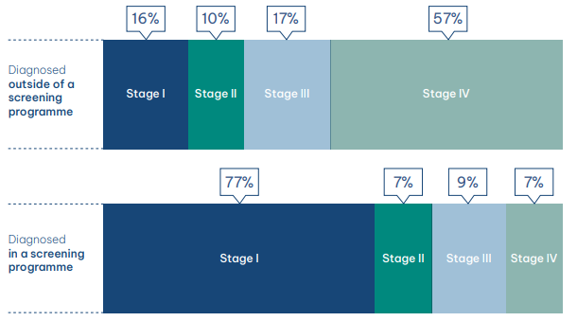
Screening for lung cancer
Screening plays a pivotal role in the early detection of lung cancer.
Low-dose computed tomography (LDCT) screening is considered the ‘gold standard’ of screening. It enables the earlier detection of lung cancer and improves survival.
Screening trials and implementation studies have shown that LDCT screening reduces mortality by 25% and increases the 20-year survival rate to at least 80%.¹⁻⁵
Using a low level of radiation, LDCT scans build a 3D profile of the inside of the body to allow for the identification of malignant nodules in the lungs.⁶
LDCT screening is effective in high-risk,
non-symptomatic populations.⁷
Risk criteria vary depending on the population, but age, smoking history and family history of lung cancer are common risk factors used to assess eligibility.⁸ ⁹
Figure 1. Stages of lung cancer diagnosed inside and outside of a screening programme¹⁰
Figure adapted by The Health Policy Partnership with permission from Sands et al. (2021)¹¹
de Koning HJ, van der Aalst CM, de Jong PA, et al. 2020. N Engl J Med 382(6): 503-13
Aberle DR, Adams AM, Berg CD, et al. 2011. N Engl J Med 365(5): 395-409
Field JK, Vulkan D, Davies MPA, et al. 2021. Lancet Reg Health Eur 10(100179): 1-11
Bonney A, Malouf R, Marchal C, et al. 2022. Cochrane Database Syst Rev: 10.1002/14651858.CD013829
Henschke C, Yip R, Shaham D, et al. 2023. Radiology 309(2): 1-8
National Cancer Institute. https://www.cancer.gov/publications/dictionaries/cancer-terms/def/ldct [Accessed 09/04/25]
Balata H, Quaife SL, Craig C, et al. 2022. Clin Oncol 34: 708-715
Bray F, Laversanne M, Sung H, et al. 2024. CA Can J Clin 74(3): 229-63
Zou K, Sun P, Huang H, et al. 2022. JNCI 2(4): 216-25
The Health Policy Partnership, Albreht, T, Baird A, et al. 2022. Lung cancer in Europe: the way forward
Sands J, Tammemägi MC, Couraud S, et al. 2021. J Thorac Oncol 16(1): 37-53
Notes:
[For more information on this, please see page 12 of the guidance document: https://www.lungcancerpolicynetwork.com/app/uploads/Step-by-step-guide-organising-workshops-to-advance-lung-cancer-screening]

Slide 8

Readiness for implementation is the ability of a health system to rapidly and sustainably adapt policies, processes and infrastructure to support integration of an innovation.¹
1. The Health Policy Partnership. 2021. Fostering system readiness in cancer care: policy brief
Notes:
[For more information on this, please see page 12 of the guidance document: https://www.lungcancerpolicynetwork.com/app/uploads/Step-by-step-guide-organising-workshops-to-advance-lung-cancer-screening]

Slide 9

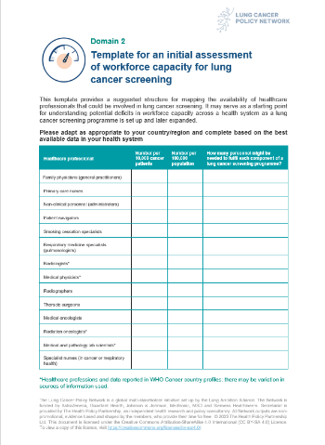
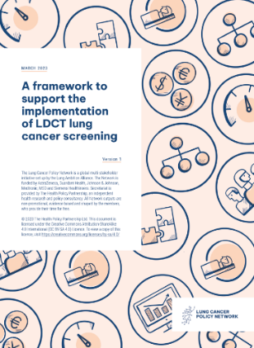
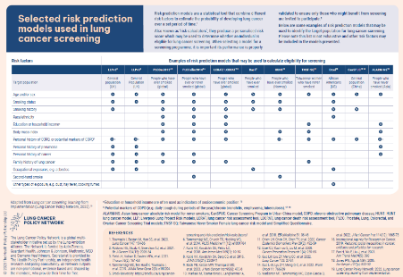
Implementation framework for LDCT screening
The Lung Cancer Policy Network developed a comprehensive framework that enables users to assess system readiness for LDCT screening implementation. It helps users to:
understand health system readiness for implementation
generate a detailed plan for implementation, including how gaps in service provision may be addressed
identify specific asks that can be used to inform policy engagement activities
deliver a robust assessment of the implementation needs to inform decision-making.
Notes:
[For more information on this, please see page 12 of the guidance document: https://www.lungcancerpolicynetwork.com/app/uploads/Step-by-step-guide-organising-workshops-to-advance-lung-cancer-screening]

Slide 10
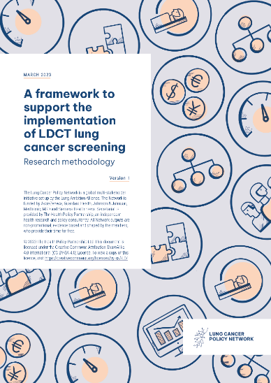
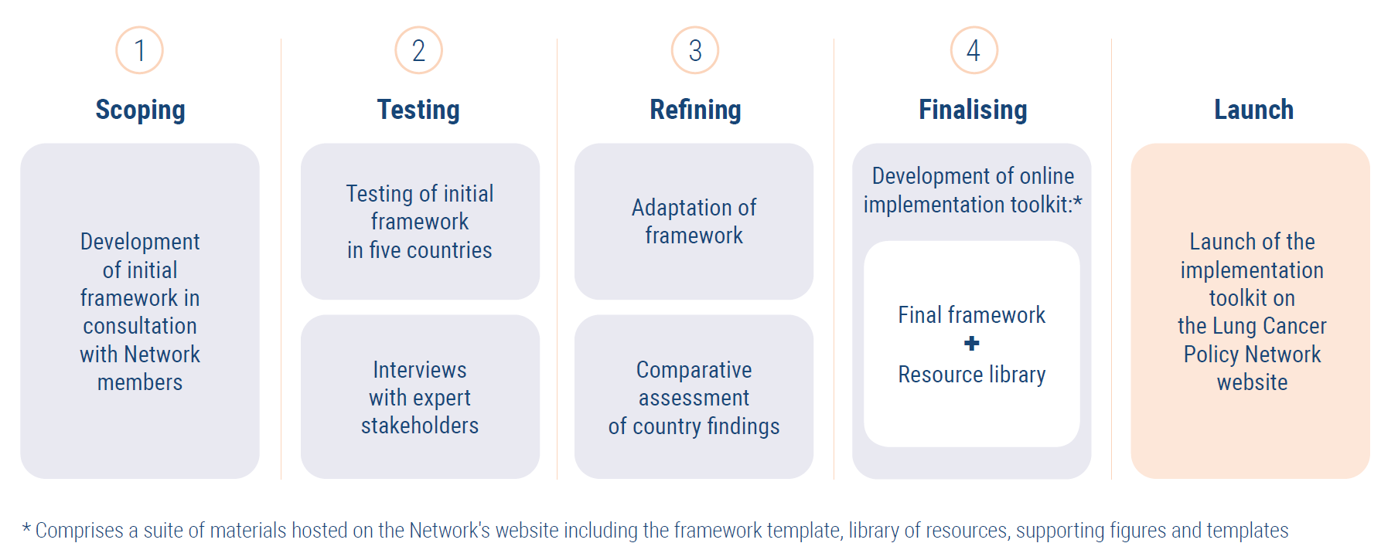
How the framework was developed
Drawing on existing frameworks, published literature, Network member expertise, and national and international guidance, the Network developed a framework specific to the implementation of LDCT screening.
It was tested in five countries: Canada, Poland, South Korea, the UK and the US.
Development process of the framework
Notes:
[For more information on this, please see page 12 of the guidance document: https://www.lungcancerpolicynetwork.com/app/uploads/Step-by-step-guide-organising-workshops-to-advance-lung-cancer-screening]

Slide 11
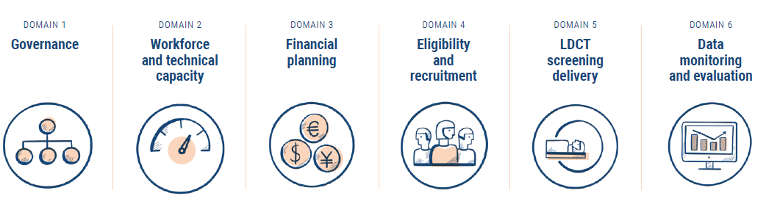
What the framework includes
The framework incorporates six core components of a health system that together enable a comprehensive assessment of the requirements for screening implementation.
Each domain comprises questions designed to:
  assess the governance, capacity and infrastructure needed in a country or region
  guide the planning required at each stage of the lung cancer care pathway to enable the implementation of organised LDCT screening.
Notes:
[For more information on this, please see page 12 of the guidance document: https://www.lungcancerpolicynetwork.com/app/uploads/Step-by-step-guide-organising-workshops-to-advance-lung-cancer-screening]

Slide 12

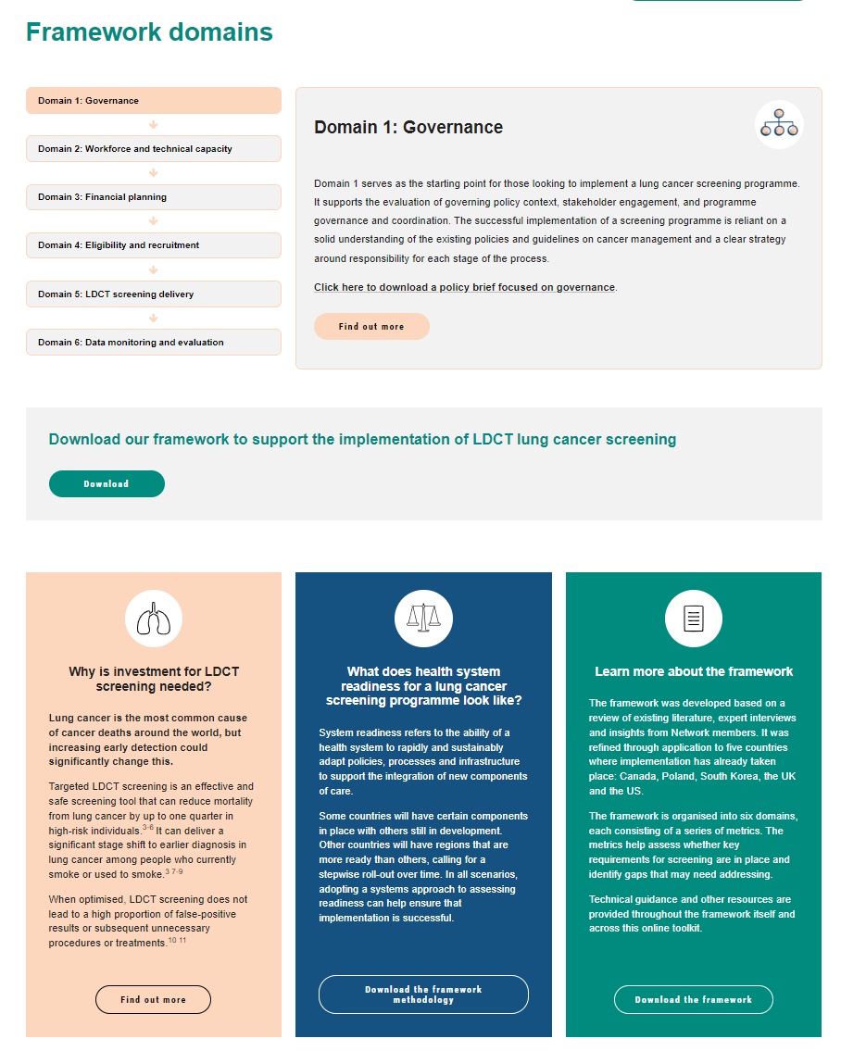
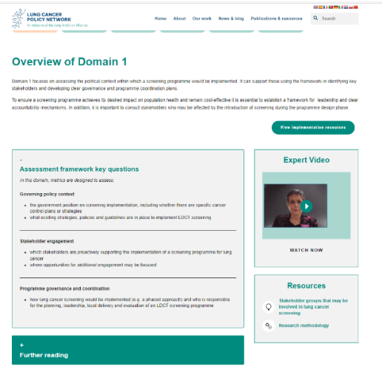
Building the LDCT screening evidence base to inform policy
The Network has developed an implementation toolkit of materials to support the application of the implementation framework to a location.
The toolkit is a free-to-use resource that includes:
implementation framework
methodology
expert videos
insights into each domain of the health system
a resource library.
Notes:
[For more information on this, please see page 12 of the guidance document: https://www.lungcancerpolicynetwork.com/app/uploads/Step-by-step-guide-organising-workshops-to-advance-lung-cancer-screening]

Slide 13

Domain 1: Governance
Implementation framework workshop

Slide 14
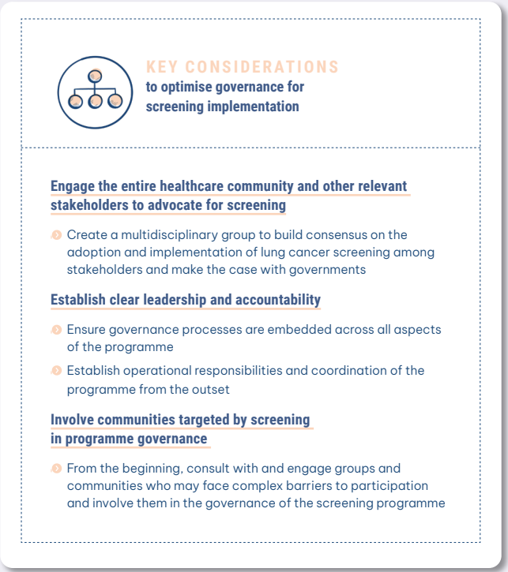
Effective governance for
LDCT screening programmes
Why is this important?
The governance of a lung screening
programme should identify who is responsible
for each aspect of programme delivery.
Establishing clear and robust governance is
central to the successful implementation of
LDCT screening programmes for lung cancer.
Establishing clear governance can help those planning the implementation of screening to identify who will have responsibility for:
screening policies
guidelines and standards
programme delivery
programme monitoring for quality assurance
the evaluation of system performance and its impact on health outcomes.
Notes:
[For more information on this, please see page 13 of the guidance document: https://www.lungcancerpolicynetwork.com/app/uploads/Step-by-step-guide-organising-workshops-to-advance-lung-cancer-screening]

Slide 15
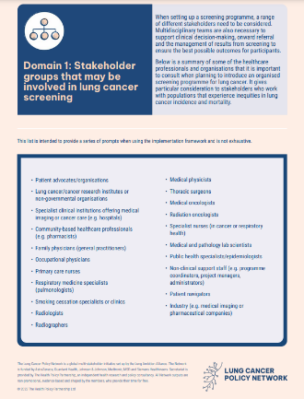
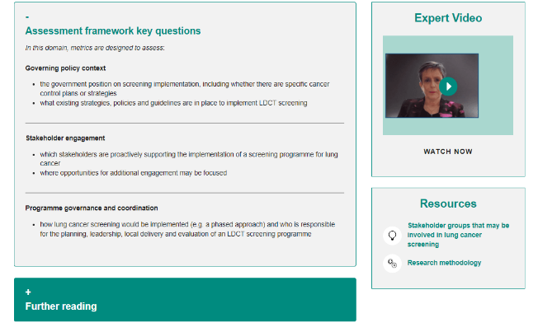
Effective governance for
LDCT screening programmes
Applying the framework can help:
  identify any existing strategies, policies or guidance
  plan how to engage the healthcare community and other relevant stakeholders
  design the governance structures for the programme.
Notes:
[For more information on this, please see page 13 of the guidance document: https://www.lungcancerpolicynetwork.com/app/uploads/Step-by-step-guide-organising-workshops-to-advance-lung-cancer-screening]

Slide 16
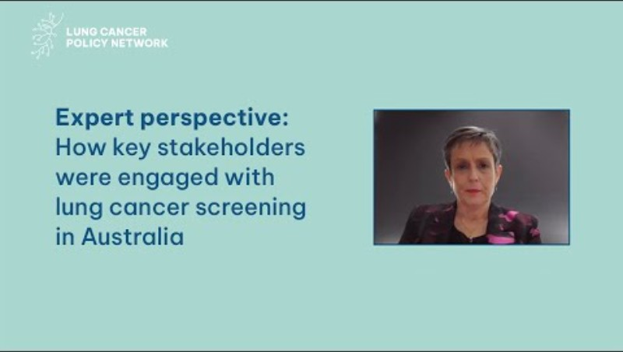
Expert perspective video: Dorothy Keefe, Cancer Australia, Australia
Notes:
[For the video to be playable, please enable content in PowerPoint. Otherwise, please visit: https://www.youtube.com/watch?v=0sW_dcrwoIg]
[For more information on this, please see page 13 of the guidance document: https://www.lungcancerpolicynetwork.com/app/uploads/Step-by-step-guide-organising-workshops-to-advance-lung-cancer-screening]

Slide 17
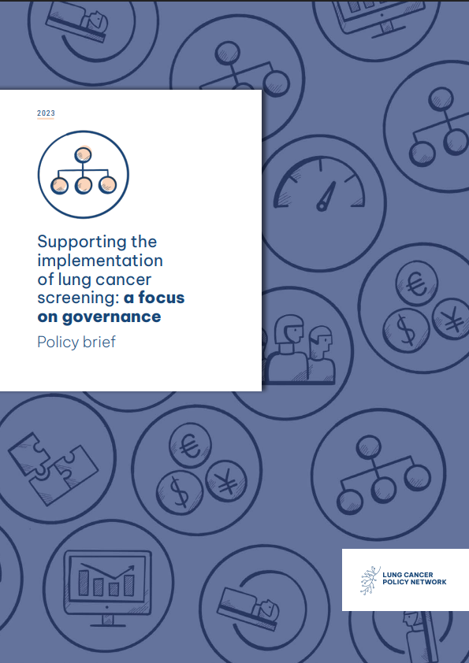

Facilitated discussion
Goal
To explore and define the governance structures, roles and stakeholder engagement strategies necessary for implementing an LDCT screening programme for lung cancer that is consistent
and high-quality.
Discussion topics
Governing policy context
Stakeholder engagement
Programme governance and coordination
Notes:
[For more information on this, please see page 13–15 of the guidance document: https://www.lungcancerpolicynetwork.com/app/uploads/Step-by-step-guide-organising-workshops-to-advance-lung-cancer-screening]

Slide 18
Summary of discussion
Notes:
[This is an optional slide that you can use to write a summary of key discussion points]

Slide 19

Domain 2: Workforce and technical capacity
Implementation framework workshop

Slide 20
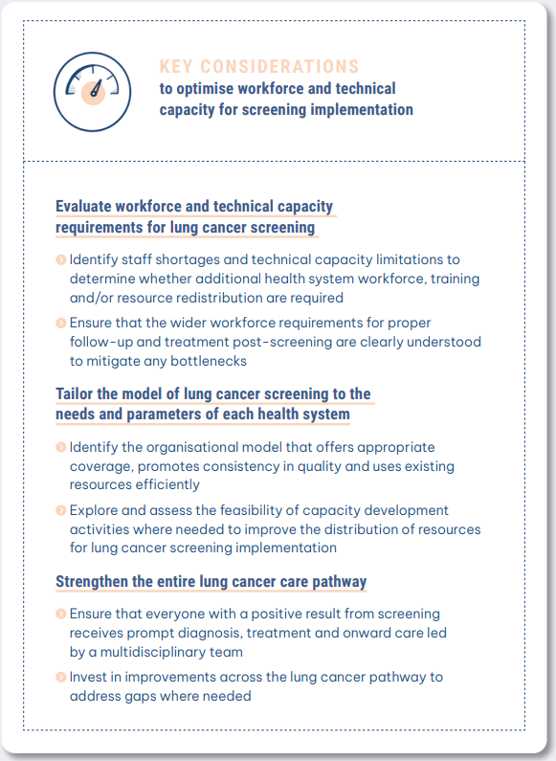
Workforce and technical capacity for LDCT lung cancer screening
Why is this important?
The implementation of a lung cancer screening programme requires sufficient human and technical capacity to perform and interpret LDCT scans.
This necessitates careful assessment and planning across the entire care pathway for lung cancer to anticipate the impact of an increased number of people requiring diagnosis and treatment.
Each country will need to assess its workforce capacity and the technical requirements to make lung cancer screening operational within its health system.
Notes:
[For more information on this, please see page 16 of the guidance document: https://www.lungcancerpolicynetwork.com/app/uploads/Step-by-step-guide-organising-workshops-to-advance-lung-cancer-screening]

Slide 21
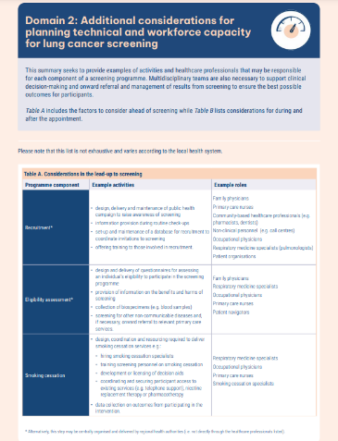
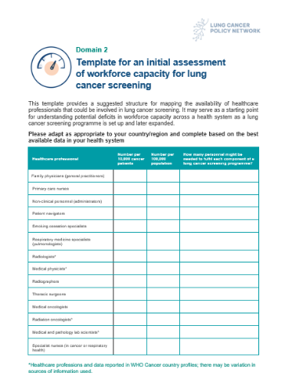
Workforce and technical capacity for LDCT lung cancer screening
Applying the framework can help:
evaluate workforce requirements for lung
cancer
assess and plan for the technical requirements around screening
consider the ideal model for screening implementation.
Notes:
[For more information on this, please see page 16 of the guidance document: https://www.lungcancerpolicynetwork.com/app/uploads/Step-by-step-guide-organising-workshops-to-advance-lung-cancer-screening]

Slide 22
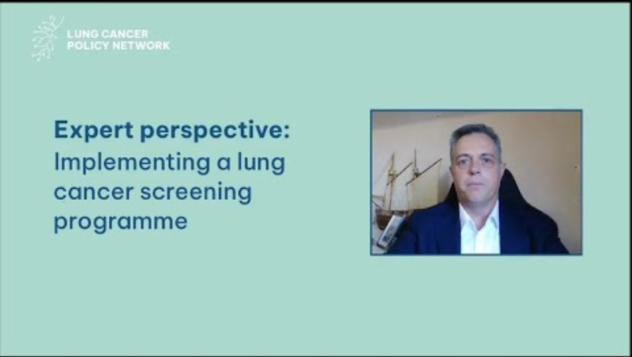
Expert perspective video: Ante Marušić, Telemedicine Clinic, Croatia
Notes:
[For the video to be playable, please enable content in PowerPoint. Otherwise, please visit: https://youtu.be/28POe7-_DEY?si=wcMWjBWQQbYFRxEz]
[For more information on this, please see page 16 of the guidance document: https://www.lungcancerpolicynetwork.com/app/uploads/Step-by-step-guide-organising-workshops-to-advance-lung-cancer-screening]

Slide 23
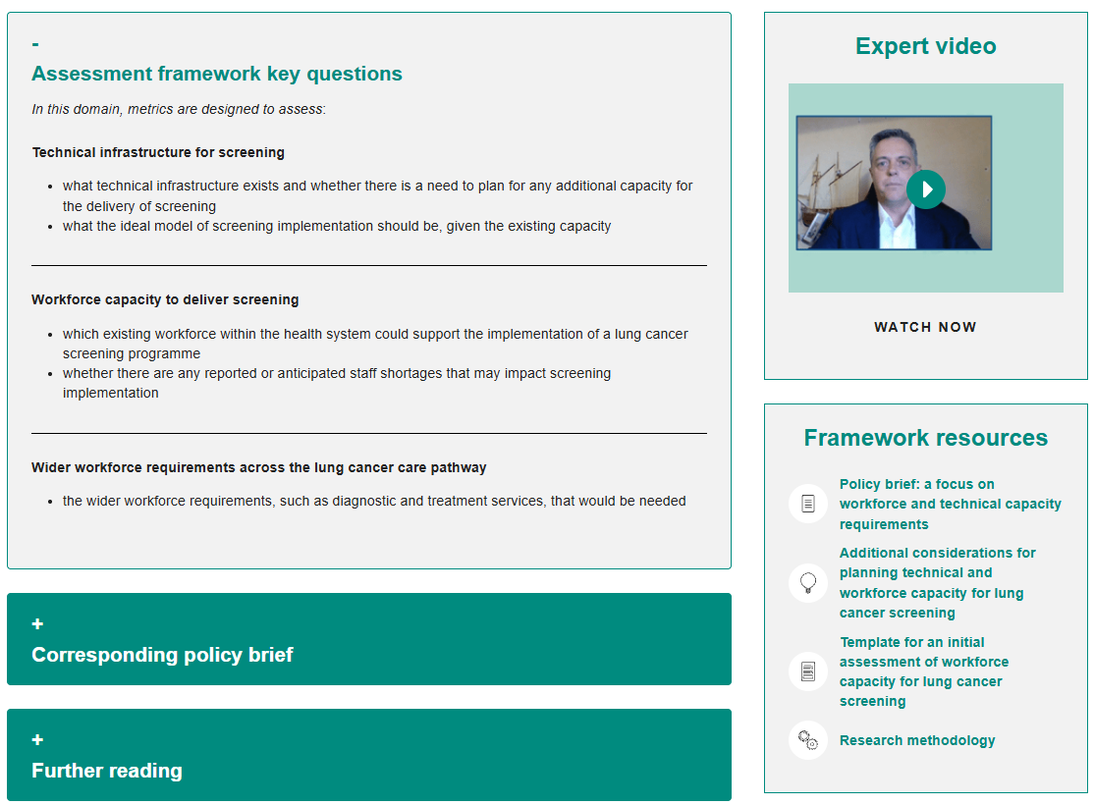
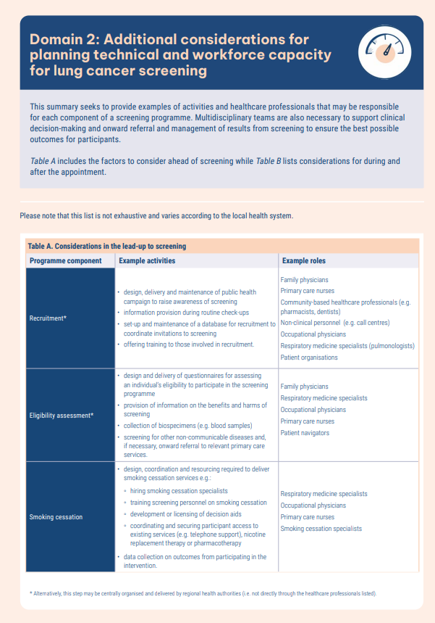
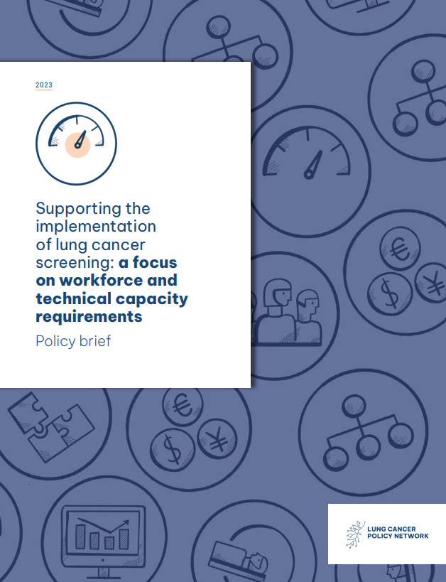
Facilitated discussion
Goal
To identify any gaps in the current technical infrastructure and workforce capacity that would impede the implementation or optimisation of lung cancer screening.
Discussion topics
Technical infrastructure for screening
Workforce capacity to deliver screening
Wider workforce requirements along the lung cancer care pathway
Notes:
[For more information on this, please see page 16–18 of the guidance document: https://www.lungcancerpolicynetwork.com/app/uploads/Step-by-step-guide-organising-workshops-to-advance-lung-cancer-screening]

Slide 24
Summary of discussion
Notes:
[This is an optional slide that you can use to write a summary of key discussion points]

Slide 25

Domain 3: Financial planning
Implementation framework workshop

Slide 26
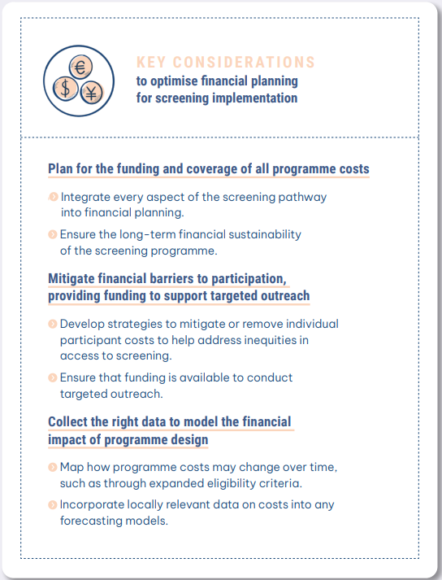
Financial planning for LDCT screening programmes
Why is this important?
Screening programmes are complex and span several areas of healthcare services. So, it is essential to ensure that all aspects of a programme are resourced and budgeted for.
The design of a programme, including the delivery of screening, will influence its cost-effectiveness and long-term feasibility.
When planning how to finance a screening programme, any existing gaps or deficits along the care pathway, including barriers to participation − for example, out-of-pocket costs − need to be identified and addressed.
Notes:
[For more information on this, please see page 19 of the guidance document: https://www.lungcancerpolicynetwork.com/app/uploads/Step-by-step-guide-organising-workshops-to-advance-lung-cancer-screening]

Slide 27
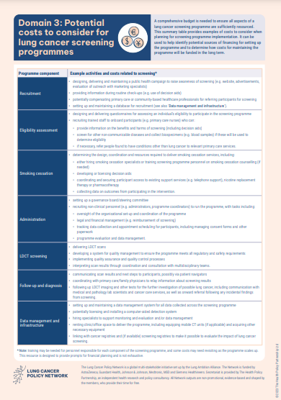
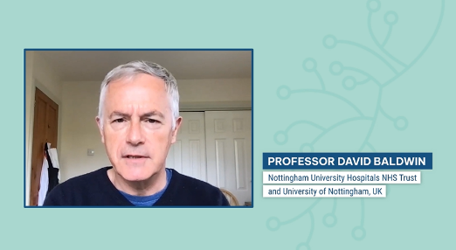
Financial planning for LDCT screening programmes
Applying the framework can help:
accurately anticipate the costs of implementing a screening programme
determine how the programme may be financed
consider the economic evaluations that have taken place.
Notes:
[For more information on this, please see page 19 of the guidance document: https://www.lungcancerpolicynetwork.com/app/uploads/Step-by-step-guide-organising-workshops-to-advance-lung-cancer-screening]

Slide 28
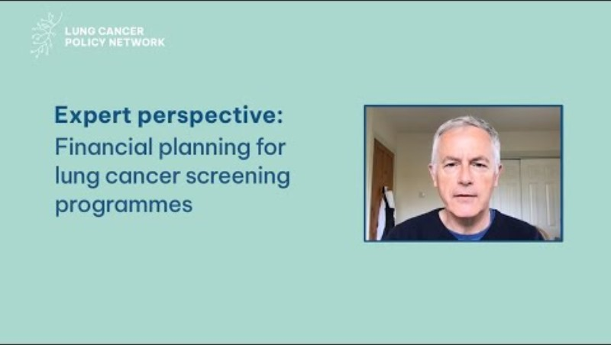
Expert perspective video: David Baldwin, University of Nottingham, England
Notes:
[For the video to be playable, please enable content in PowerPoint. Otherwise, please visit: https://youtu.be/mcK5YkOwR3U?si=-Rs42vdk8V7U39Zc]
[For more information on this, please see page 19 of the guidance document: https://www.lungcancerpolicynetwork.com/app/uploads/Step-by-step-guide-organising-workshops-to-advance-lung-cancer-screening]

Slide 29
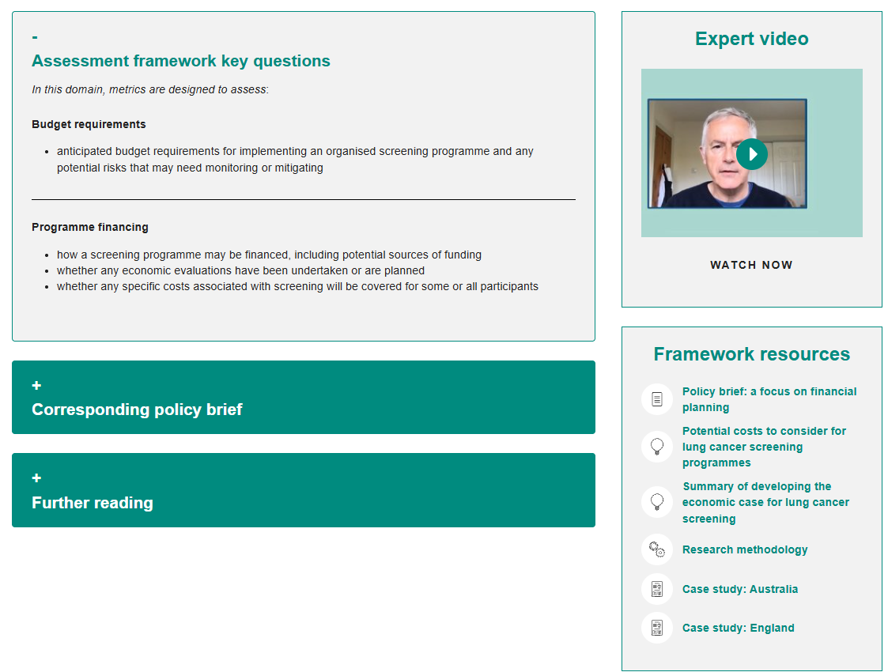
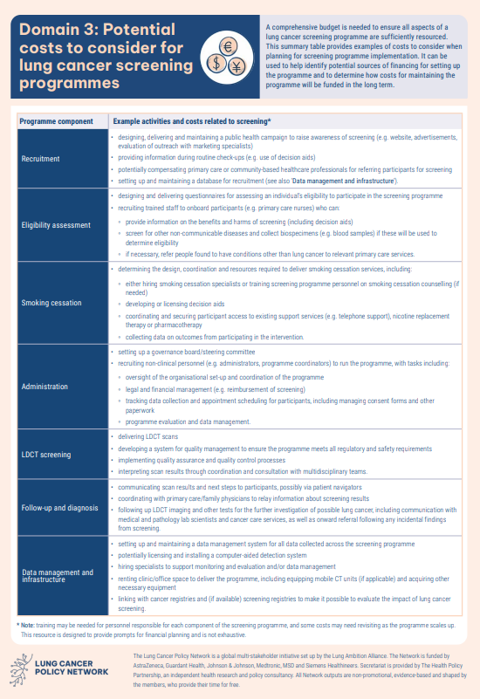
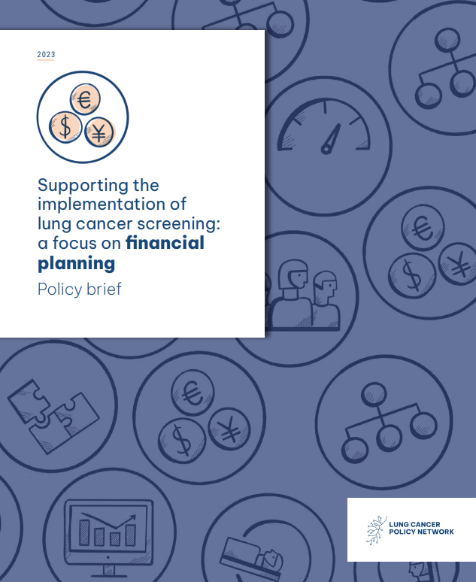
Facilitated discussion
Goal
To understand the budget requirements for screening and explore how an LDCT screening programme for lung cancer can be financed.
Discussion topics
Budget requirements
Programme financing
Notes:
[For more information on this, please see page 19–21 of the guidance document: https://www.lungcancerpolicynetwork.com/app/uploads/Step-by-step-guide-organising-workshops-to-advance-lung-cancer-screening]

Slide 30
Summary of discussion
Notes:
[This is an optional slide that you can use to write a summary of key discussion points]

Slide 31

Domain 4: Eligibility criteria and recruitment
Implementation framework workshop

Slide 32
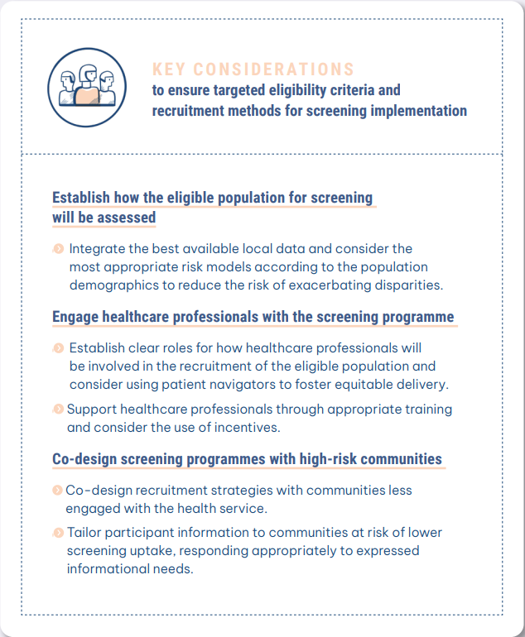
Targeted eligibility criteria and recruitment methods for LDCT screening programmes
Why is this important?
Targeted screening programmes for lung cancer need to secure the participation of people who are at high risk of developing the disease and would benefit most from screening.
The engagement of healthcare professionals is also essential a programme’s success; they have a significant role in the recruitment and referral of people for screening.
Many people at high risk of lung cancer are also underserved by health systems and public health programmes. To avoid exacerbating existing inequities, recruitment strategies must use outreach methods that address potential barriers to participation.
Notes:
[For more information on this, please see page 22 of the guidance document: https://www.lungcancerpolicynetwork.com/app/uploads/Step-by-step-guide-organising-workshops-to-advance-lung-cancer-screening]

Slide 33
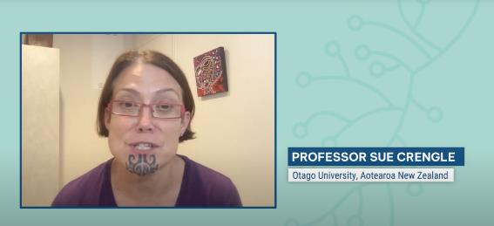
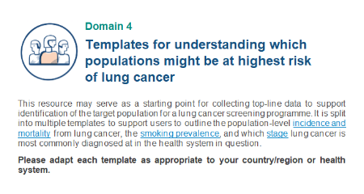
Targeted eligibility criteria and recruitment methods for LDCT screening programmes
Applying the framework can help:
define the eligible population for lung cancer screening
consider the informational needs of the people who are eligible
establish processes for recruitment
design recruitment strategies that mitigate health inequities.
Notes:
[For more information on this, please see page 22 of the guidance document: https://www.lungcancerpolicynetwork.com/app/uploads/Step-by-step-guide-organising-workshops-to-advance-lung-cancer-screening]

Slide 34
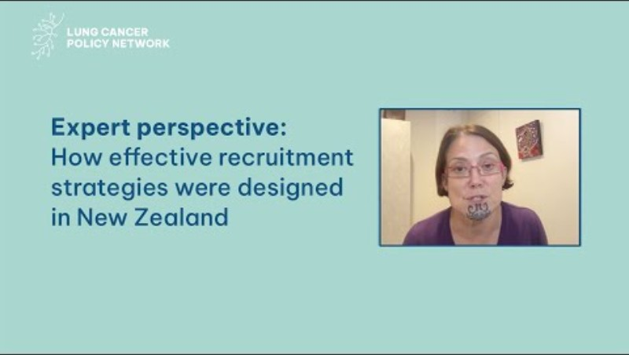
Expert perspective video: Sue Crengle, University of Otago, Aotearoa New Zealand
Notes:
[For the video to be playable, please enable content in PowerPoint. Otherwise, please visit: https://youtu.be/JbEjV-pWESA?si=-IXKjFhcNCixPvKd]
[For more information on this, please see page 22 of the guidance document: https://www.lungcancerpolicynetwork.com/app/uploads/Step-by-step-guide-organising-workshops-to-advance-lung-cancer-screening]

Slide 35
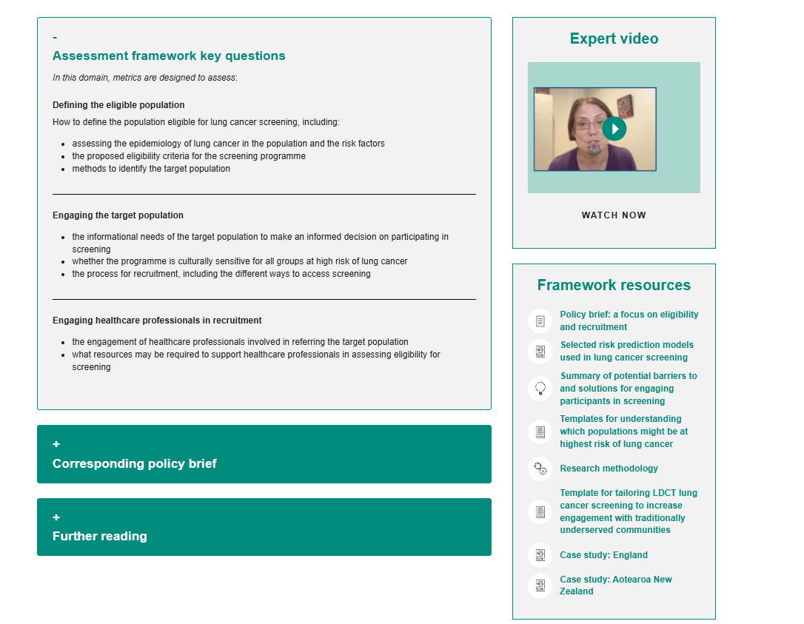
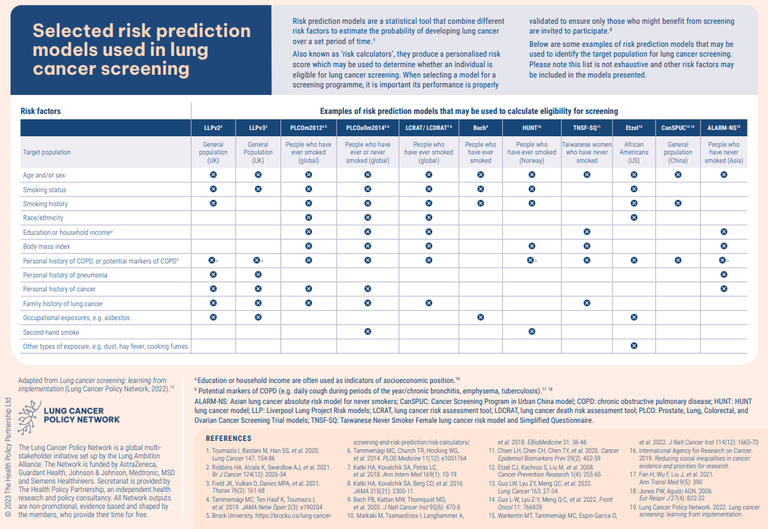
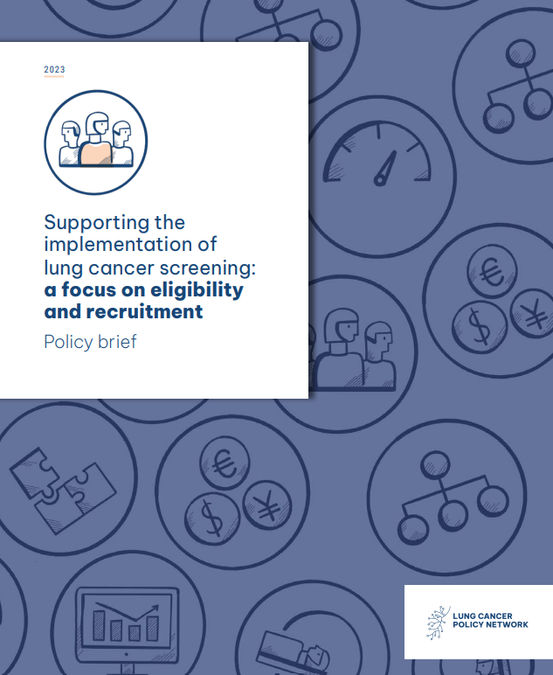
Facilitated discussion
Goal
To collaboratively explore and define the eligible screening population and identify ways to engage with them, as well as engaging healthcare professionals to refer people to screening.
Discussion topics
Defining the eligible population
Engaging the target population
Engaging healthcare professionals in recruitment
Notes:
[For more information on this, please see page 22–26 of the guidance document: https://www.lungcancerpolicynetwork.com/app/uploads/Step-by-step-guide-organising-workshops-to-advance-lung-cancer-screening]

Slide 36
Summary of discussion
Notes:
[This is an optional slide that you can use to write a summary of key discussion points]

Slide 37

Domain 5: LDCT screening delivery
Implementation framework workshop

Slide 38
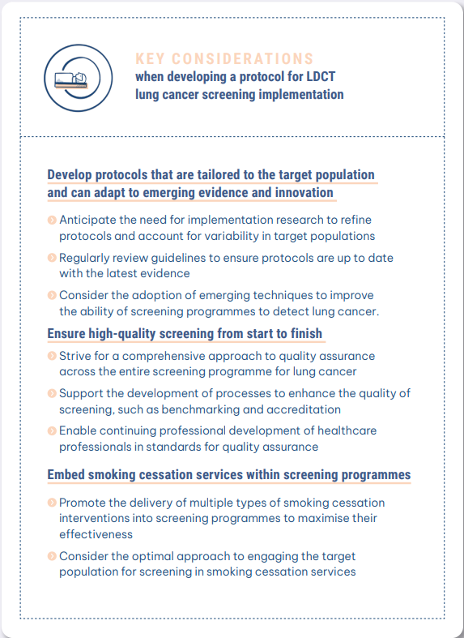
Establishing a protocol for the delivery of LDCT screening programmes
Why is this important?
Screening should be safe, precise, validated and acceptable to the population. A clear protocol ensures that these criteria are met in every component of the screening programme.
A clear protocol also helps health system leaders maximise the unique opportunity offered by a lung cancer screening programme to engage a population at high risk of lung cancer in other public health initiatives, such as smoking cessation.
Notes:
[For more information on this, please see page 27 of the guidance document: https://www.lungcancerpolicynetwork.com/app/uploads/Step-by-step-guide-organising-workshops-to-advance-lung-cancer-screening]

Slide 39

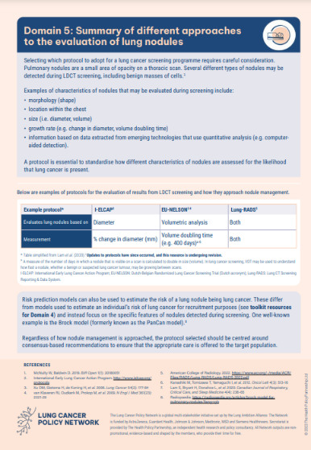
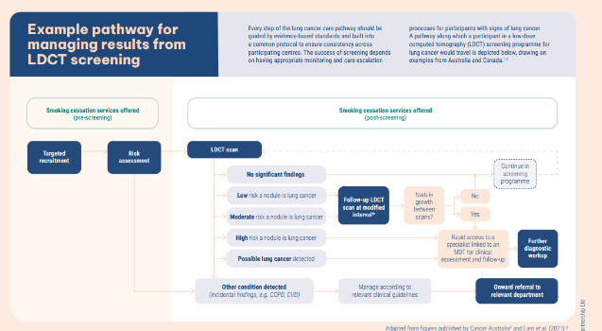
Establishing a protocol for the delivery of LDCT screening programmes
Applying the framework can help:
define the screening protocol
establish an ongoing process to monitor and manage quality
plan the integration of relevant public health initiatives (e.g. smoking cessation)
design pathways that include diagnostic work-up and participant follow-up.
Notes:
[For more information on this, please see page 27 of the guidance document: https://www.lungcancerpolicynetwork.com/app/uploads/Step-by-step-guide-organising-workshops-to-advance-lung-cancer-screening]

Slide 40

Expert perspective video: Joelle Fathi, GO2 for Lung Cancer, US
Notes:
[For the video to be playable, please enable content in PowerPoint. Otherwise, please visit: https://youtu.be/YT59ccfbrWg?si=xZdnaKwK1XPNC5ep]
[For more information on this, please see page 27 of the guidance document: https://www.lungcancerpolicynetwork.com/app/uploads/Step-by-step-guide-organising-workshops-to-advance-lung-cancer-screening]

Slide 41
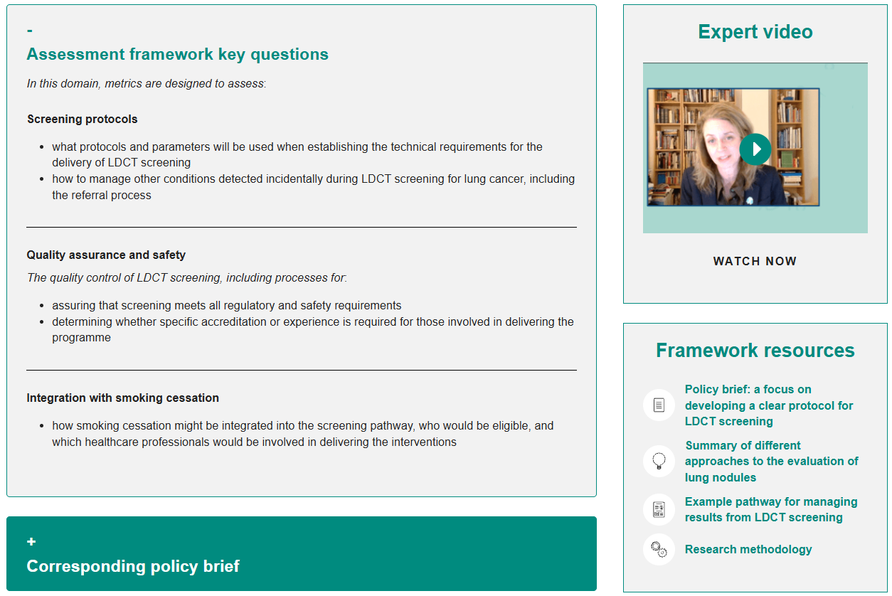
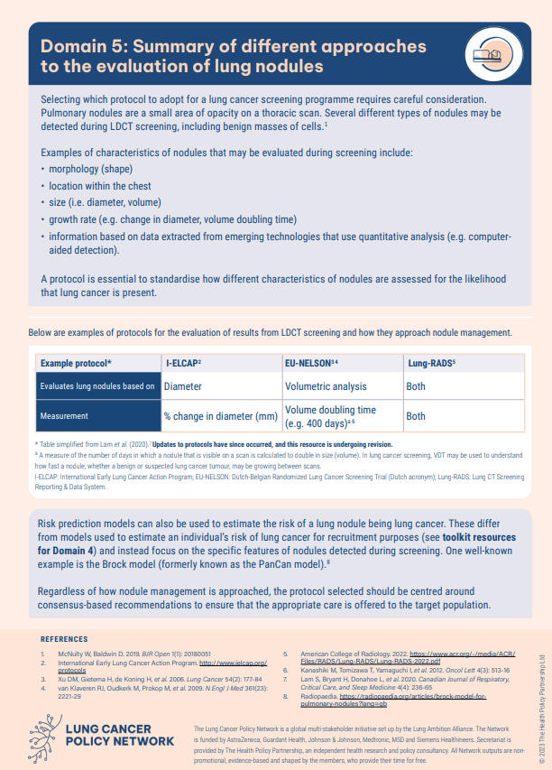
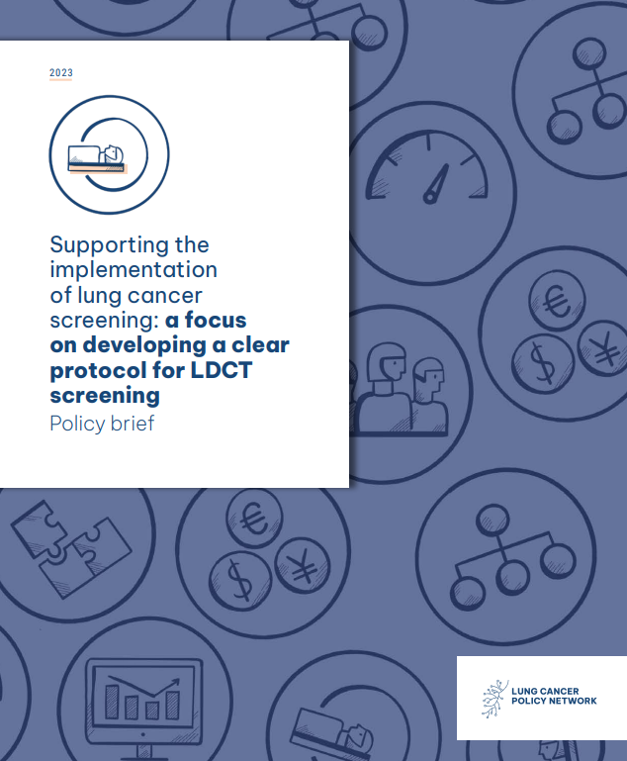
Facilitated discussion
Goal
To explore the protocol, quality assurance process, follow-up and diagnostic pathway necessary to implement an LDCT screening programme that is consistent and high-quality.
Discussion topics
Screening protocols
Quality assurance and safety
Integration with smoking cessation
Follow-up and diagnosis
Notes:
[For more information on this, please see page 27–31 of the guidance document: https://www.lungcancerpolicynetwork.com/app/uploads/Step-by-step-guide-organising-workshops-to-advance-lung-cancer-screening]

Slide 42
Summary of discussion
Notes:
[This is an optional slide that you can use to write a summary of key discussion points]

Slide 43

Domain 6: Data monitoring and evaluation
Implementation framework workshop

Slide 44
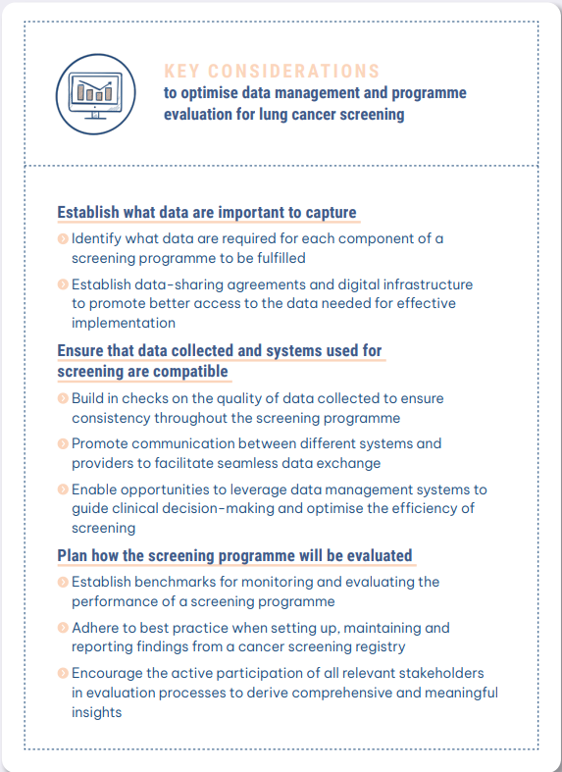
Planning for data management, monitoring and evaluation of LDCT screening programmes
Why is this important?
Because screening programmes are complex, they require comprehensive and well-organised health information systems.
Robust data are key to evaluating the success of the programme, assessing risks, and determining the true impact of lung cancer screening on population health.
Notes:
[For more information on this, please see page 32 of the guidance document: https://www.lungcancerpolicynetwork.com/app/uploads/Step-by-step-guide-organising-workshops-to-advance-lung-cancer-screening]

Slide 45
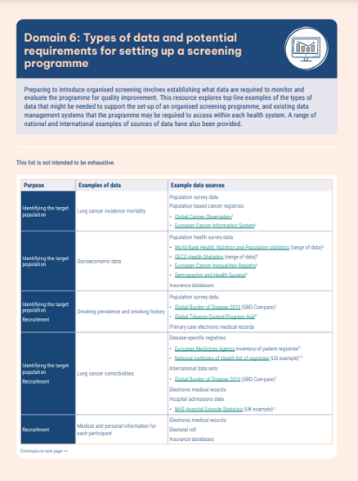
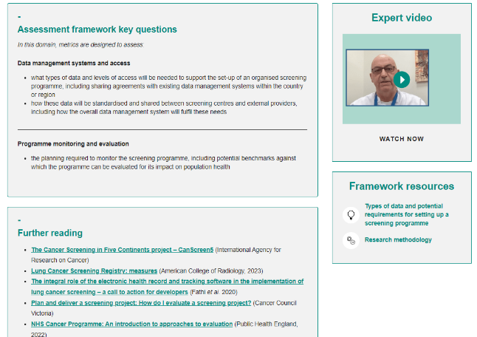
Planning for data management, monitoring and evaluation of LDCT screening programmes
Applying the framework can help:
assess what types of data and levels of access are needed
establish how data will be standardised and shared
plan how the screening programme for lung cancer will be monitored and evaluated.
Notes:
[For more information on this, please see page 32 of the guidance document: https://www.lungcancerpolicynetwork.com/app/uploads/Step-by-step-guide-organising-workshops-to-advance-lung-cancer-screening]

Slide 46
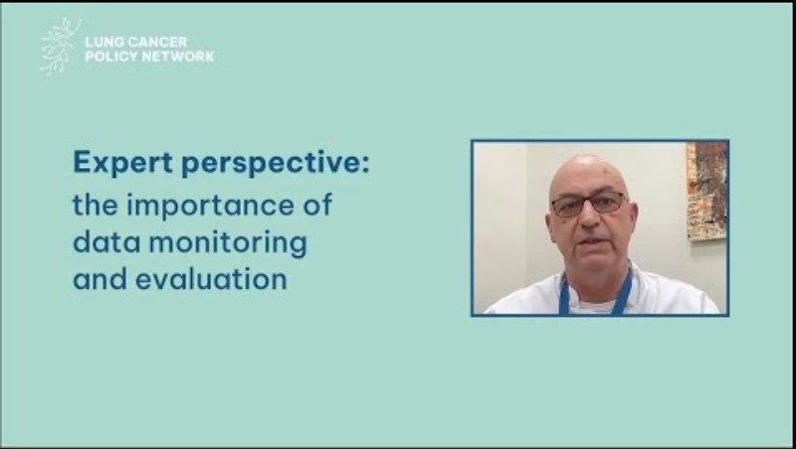
Expert perspective video: Witold Rzyman, Medical University of Gdańsk, Poland
Notes:
[For the video to be playable, please enable content in PowerPoint. Otherwise, please visit: https://youtu.be/VXdj49k-Jj0?si=1j3sdf-QYFxLhprx]
[For more information on this, please see page 32 of the guidance document: https://www.lungcancerpolicynetwork.com/app/uploads/Step-by-step-guide-organising-workshops-to-advance-lung-cancer-screening]

Slide 47
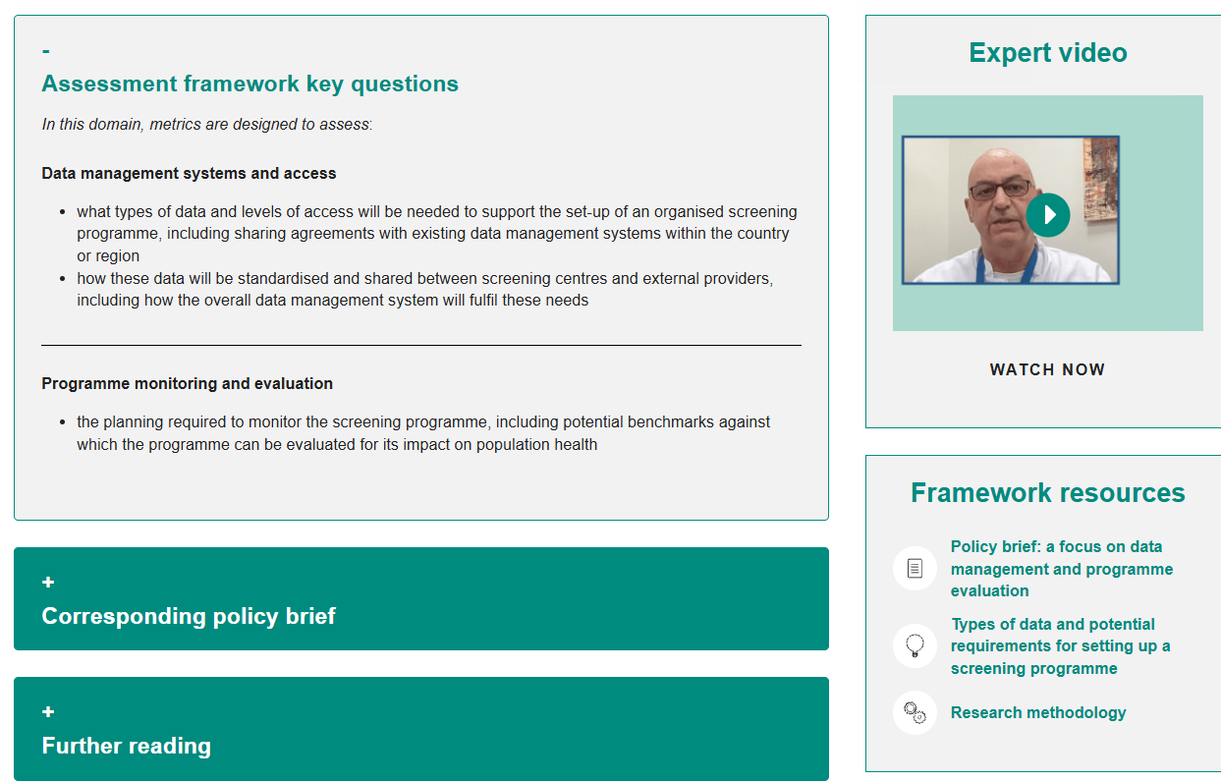
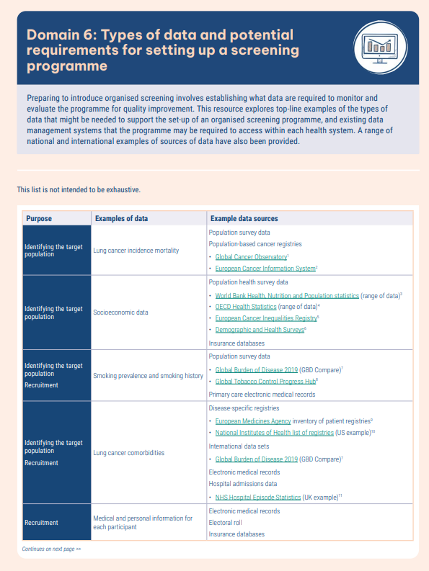
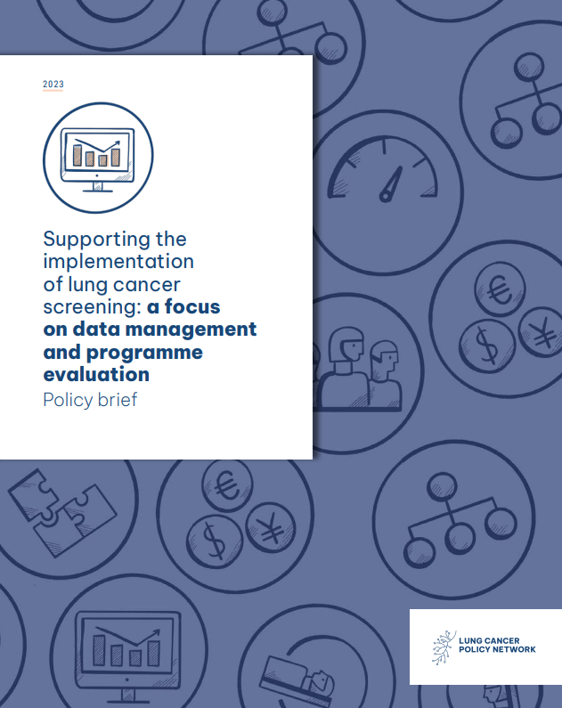
Facilitated discussion
Goal
To explore the data needed to support the set-up of a screening programme for lung cancer, and find out what is needed to appropriately monitor and evaluate it.
Discussion groups
Data management systems and access
Programme monitoring and evaluation
Notes:
[For more information on this, please see page 32–34 of the guidance document: https://www.lungcancerpolicynetwork.com/app/uploads/Step-by-step-guide-organising-workshops-to-advance-lung-cancer-screening]

Slide 48
Summary of discussion
Notes:
[This is an optional slide that you can use to write a summary of key discussion points]

Slide 49
Concluding remarks
Implementation framework workshop
Notes:
[For more information on this, please see page 35 of the guidance document: https://www.lungcancerpolicynetwork.com/app/uploads/Step-by-step-guide-organising-workshops-to-advance-lung-cancer-screening]

Slide 50
Key actions and next steps
Action | Who are we asking this of? | Extra detail/information

Slide 51
Stakeholder mapping: programme governance and coordination
Objective: To identify key stakeholders involved in programme governance, and clarify their roles and responsibilities.
Set-up
Set up flip charts with prompts: national-level governance, regional coordination, local delivery and operations, leadership and evaluation, guidelines and standards etc.
Identify stakeholders and their responsibilities
Small groups rotate every five minutes, adding relevant stakeholders, and their roles and responsibilities, to each chart. The examples of stakeholder groups can help with this.
Review and discuss
National-level governance
Regional coordination
Stakeholders | Roles and responsibilities
Stakeholders | Roles and responsibilities
Sticky note with delegate comment
Sticky note with delegate comment
Sticky note with delegate comment
Sticky note with delegate comment
Sticky note with delegate comment
Sticky note with delegate comment
Sticky note with delegate comment
Sticky note with delegate comment
Sticky note with delegate comment
Sticky note with delegate comment
Sticky note with delegate comment
Sticky note with delegate comment
Sticky note with delegate comment
Sticky note with delegate comment
Sticky note with delegate comment
Sticky note with delegate comment
Sticky note with delegate comment
Sticky note with delegate comment
Sticky note with delegate comment
Sticky note with delegate comment
Sticky note with delegate comment
Sticky note with delegate comment

Slide 52

Capacity assessment
Objective: To identify gaps between current and ideal workforce and infrastructure capacity,
and develop solutions to address them.
Set-up
Provide each group with a simple two-column template:
  Current capacity: what resources, staff and infrastructure do we have now?
  Needed capacity: what would we need to scale or improve services?
Participants work in pairs or small groups to fill out the template.
Identify gaps and suggest solutions
Use sticky notes to highlight gaps, then brainstorm potential solutions.
Test scenarios
Introduce curveball scenarios and ask how participants would adapt.
Current capacity | Needed capacity
gaps
Sticky note with delegate comment
Sticky note with delegate comment
Sticky note with delegate comment
Sticky note with delegate comment
solutions
Sticky note with delegate comment
Sticky note with delegate comment
Sticky note with delegate comment
Sticky note with delegate comment

Slide 53
Building the ideal screening pathway
Objective: To collaboratively design a care pathway for lung cancer screening that is tailored to the country/region.
Reflect on existing models
Groups discuss any current cancer screening pathways that they are aware of. What works well, and what could be adapted for lung cancer?
Review an example pathway
The example pathway for managing results from LDCT screening can help spark ideas.
Design the ideal care pathway
Using flip charts and sticky notes, groups map out each step, from invitation to follow-up care.
Compare and discuss
Sticky note with delegate comment
Sticky note with delegate comment
Sticky note with delegate comment
Sticky note with delegate comment
Sticky note with delegate comment
Sticky note with delegate comment
Sticky note with delegate comment
Sticky note with delegate comment
Sticky note with delegate comment
Sticky note with delegate comment
Sticky note with delegate comment
Sticky note with delegate comment
Sticky note with delegate comment
Sticky note with delegate comment

Slide 54
From the Lung Cancer Policy Network
Other resources on screening

Slide 55

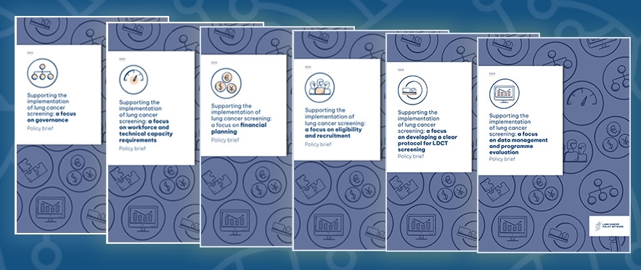
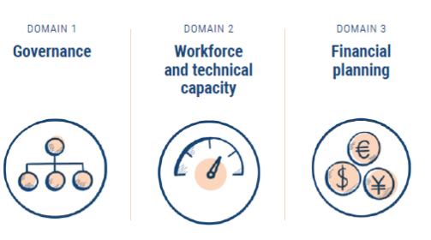

Building the LDCT screening evidence base to inform policy
To enhance engagement with policymakers on screening implementation considerations, the Network has:
  published six policy briefs, each of which details an implementation framework domain
  each brief provides:
    insights into considerations for each domain
    case studies
    policy recommendations to support the successful implementation of equitable, effective screening programmes for lung cancer.
The six domains of the health system
Each policy brief is available in English, Spanish, French, Arabic and Simplified Chinese.

Slide 56



Interactive map: a global view of LDCT screening programmes
The Network launched an interactive map and a user guide in 2022. The map is regularly updated with new information to help users:
determine the status of organised programmes, clinical trials and implementation studies for LDCT screening
use real-world examples to facilitate policy-level discussions
optimise knowledge sharing
explore a policy overview that is easy to use and understand, and puts the implementation activity into context.

Slide 57

Demonstrating the value of LDCT screening
The Network launched five factsheets; they
demonstrate that:
LDCT meets all the criteria for screening programmes
detecting lung cancer earlier through targeted screening presents an opportunity to reduce inequalities and strengthen smoking cessation efforts
earlier detection should be a public health priority
there is extensive knowledge to guide successful implementation of LDCT at scale
there is a strong economic case for detection lung cancer earlier via LDCT screening.

Slide 58

Lung cancer screening: learning from implementation
In 2022, the Network published a report, which:
explores how to optimise the planning and delivery of LDCT screening
showcases approaches to tackling screening implementation challenges
demonstrates to policymakers, in the form of a ‘blueprint’, the wealth of evidence for screening.
The report is available in English, French, Arabic, Spanish and simplified Chinese. A two-page summary of the report is also available.
LDCT screening implementation can be optimised by building on the extensive
evidence and lessons learnt from existing programmes.

Slide 59


Closing the gap: the role of global data in advancing lung cancer screening
The Network published a report in August 2025 that explores how insights from global data can help drive the implementation of effective and equitable screening programmes for lung cancer.
The report uses data from the interactive map, extensive review of the literature, and draws insights from Network members.
It highlights real-world examples on LDCT screening programmes.
It can support policymakers, screening leads, clinicians and advocates in translating evidence into action.

Slide 60
Please explore the work of the
Network further, and contact us
with any questions.

